Slide 1
Open Targets: integrating genetics, omics and chemical data for drug discovery
Winter Corporate School
EMBL Predocs, Heidelberg
Sep 11th 2019
Denise Carvalho-Silva, PhD
EMBL-EBI | Open Targets
Wellcome Genome Campus
United Kingdom

Slide 2
Workshop exercises
https://docs.targetvalidation.org/outreach/
latest-training-materials

Slide 3
This session 14:00-17:00
Introduction to Open Targets
Open Targets Platform: presentation + live demo
Coffee break → 15:15-15:30
Hands-on time
Feedback survey, wrap up, further discussion

Slide 4
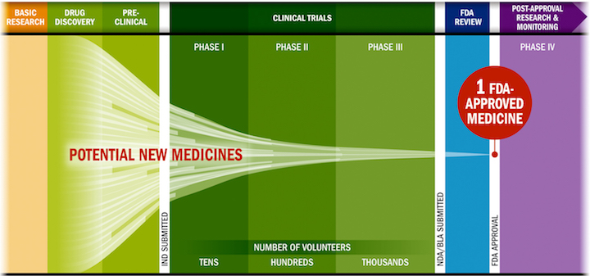
Drug discovery: some challenges
Lengthy, costly, low success rate, HIGH ATTRITION RATES
Source: PhRMA adaptation based on Tufts CSDD & School of Medicine, and FDA

Slide 5
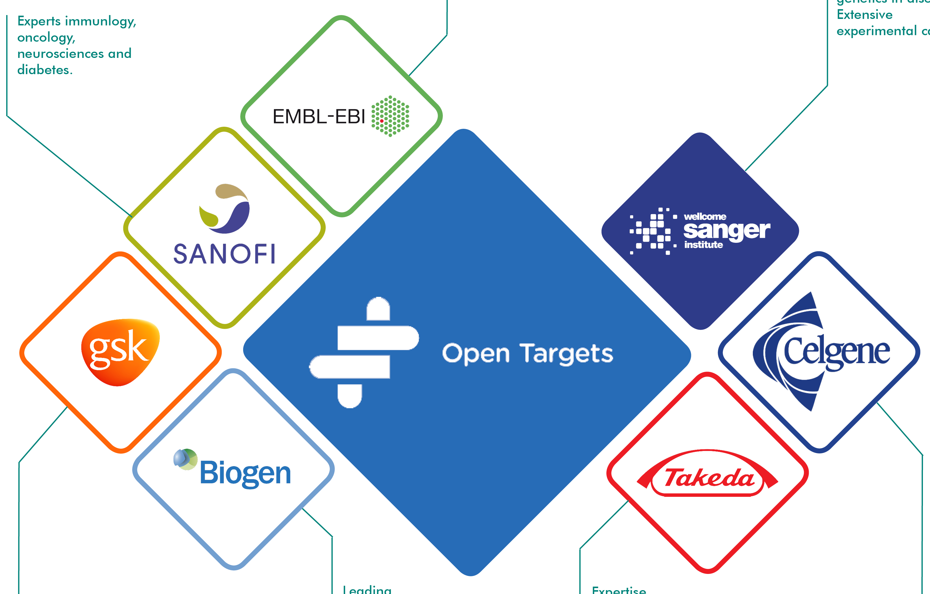
Partnership to transform drug discovery
Systematic identification and prioritisation of targets
Notes:
A shared vision to create a partnership to transform drug discovery through systematics target ID and prioritisation.
From that idea Open Targets (formerly CTTV) was started to combine the world class functional genomics expertise at Sanger with the EBI‘s excellence in bioinformatics and computational biology and the industry expertise of GSK and now Biogen as well with the aim to find out all that‘s important about a target before starting the drug development pipeline.
Thereby the pipeline would be filled with validated and valid targets with a much improved odds ratio for success.

Slide 6
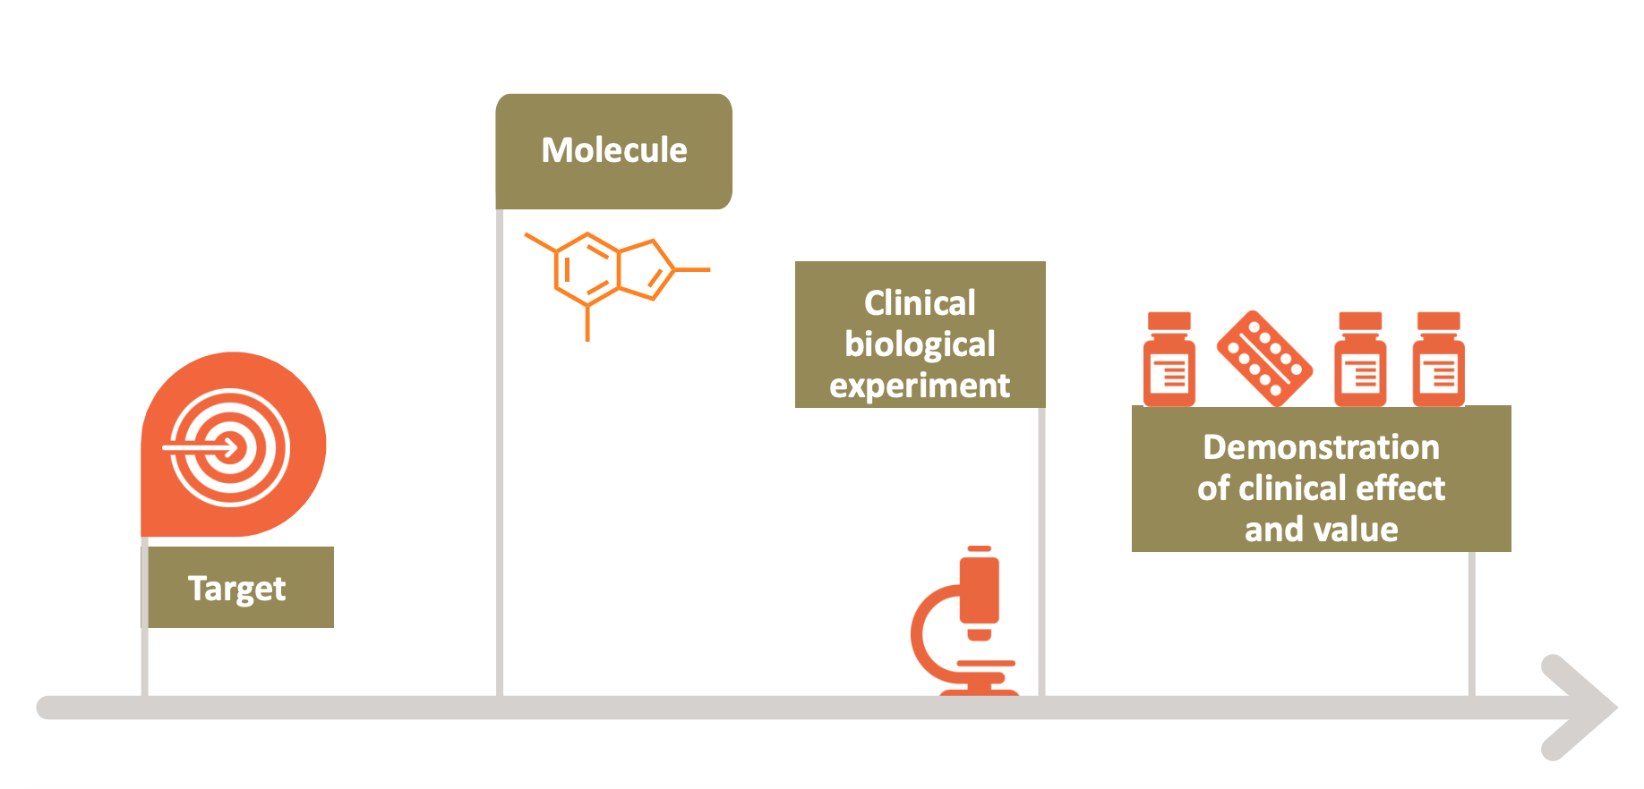
Selecting the right target
Drugs that fail are neither safe nor efficacious

Slide 7









Knowledge cycle
Public data
Experimental projects
Bioinformatics projects
DATA
GENERATION
DATA
INTEGRATION
Therapeutic hypothesis

Slide 8
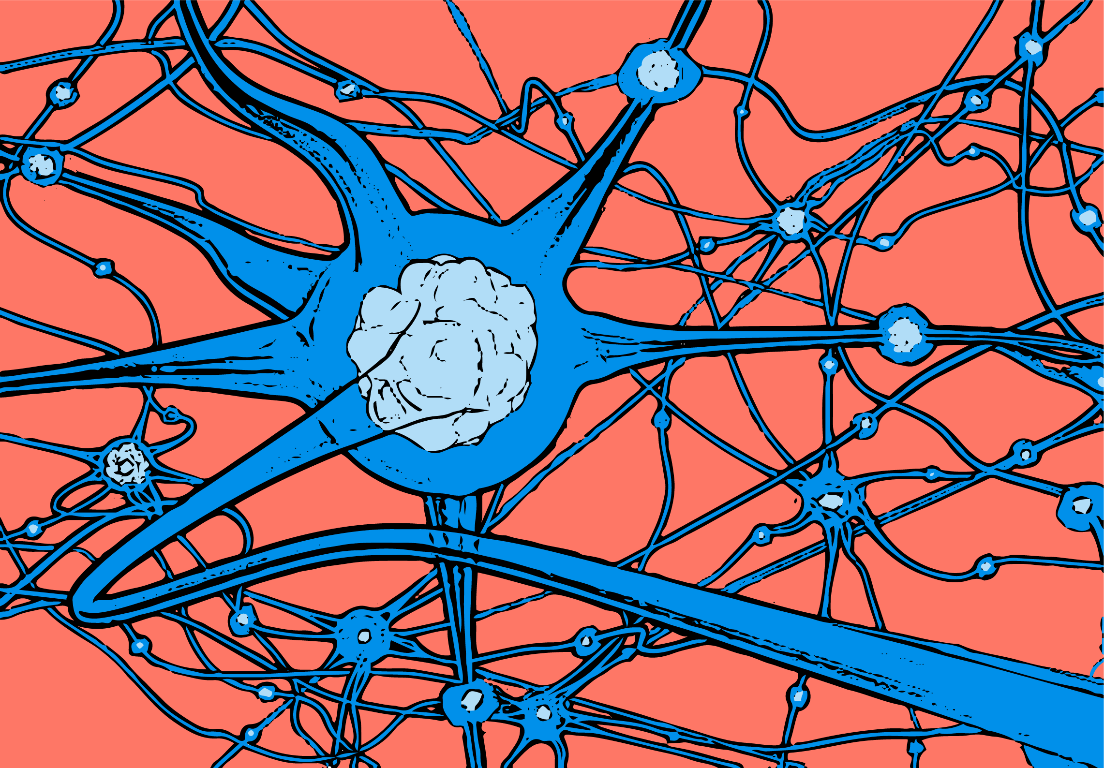
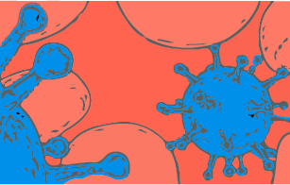
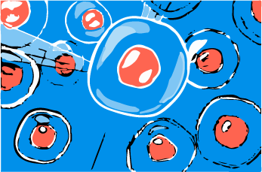
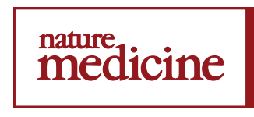

Data generation: therapeutic areas
2 complete projects
3 complete projects
3 manuscripts on bioRxiv
9 ongoing projects
7 ongoing projects
5 ongoing projects
1 publication (2019)
1 publication (2019)

Slide 9
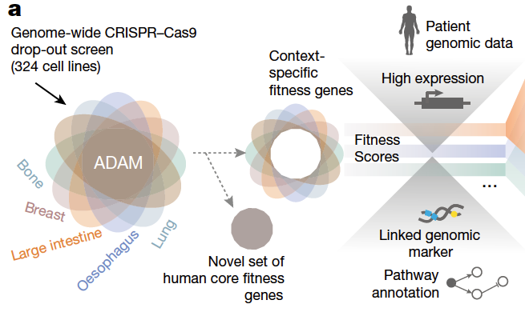
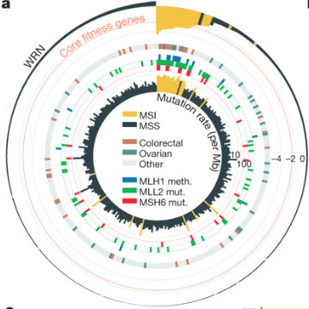
Behan et al (2019)
Data now available in the Open Targets Platform e.g.
https://www.targetvalidation.org/evidence/ENSG00000100941/EFO_0000305?view=sec:affected_pathway
WRN sustains in vivo growth in:
colorectal
ovarian
endometrial
gastric
New candidate target for tumours with MSI (WRN antagonists)
Notes:
Prioritisting targets in cancer

Slide 10
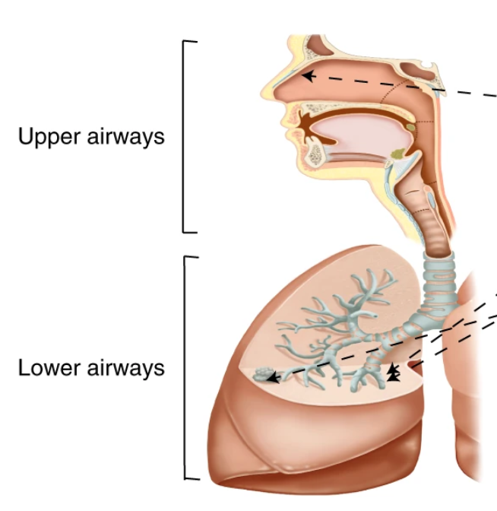
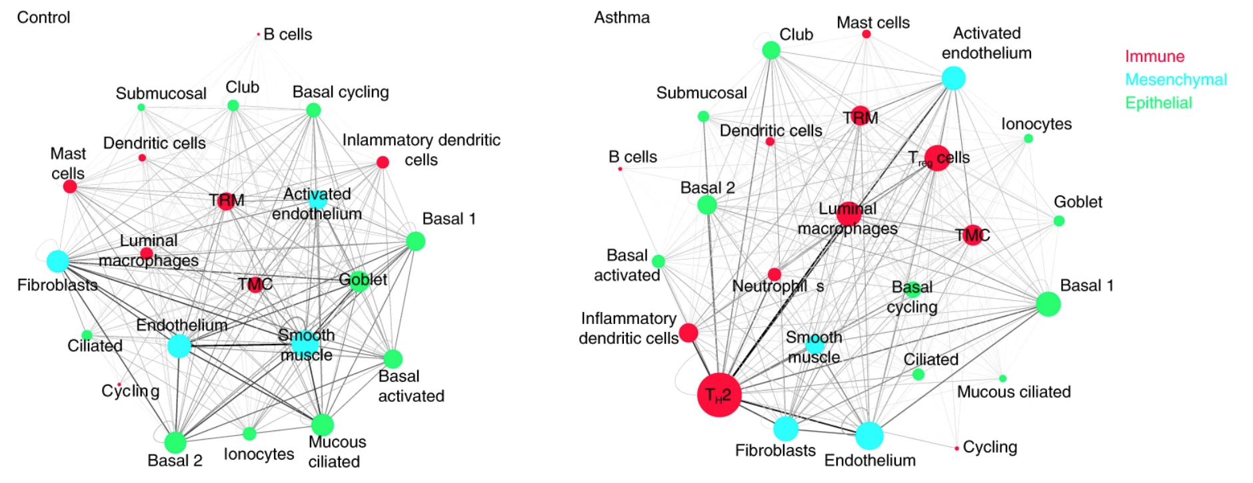
Vieira-Braga et al (2019)
Asthmatic lungs
New cell state that produces mucous
More inflammatory Th2 cells
Th2-dominant interactome
Notes:
Prioritisting pathways (communication pathways)
asthma patients and normal people
evealed the identity of each cell type, creating the first draft Human Cell Atlas of the lung
They also discovered an entirely new cell state that produces mucus in asthma patients.
differences between asthmatic and normal airways and identify how cells in the lung communicate with each other. Understanding the cells and their signals could lead to finding new drug targets for treating asthma.
A better understanding of healthy lung cells and the differences with asthmatic lungs is required to develop new effective medications.
esearchers used single cell technology to study samples from 17 people. They analysed more than 36,000 individual cells from the nasal area and from three different areas of the lung. This allowed researchers to see exactly which genes were active in each cell and identify the specific cell type.
new mucus-creating cell state - the muco-cilliated state - in asthmatic lungs,
The asthmatic lungs had many more inflammatory Th2 cells, which sent the vast majority of cellular signals in asthma,
all kinds of cells communicate with each other in order to keep the airways functioning well. But in asthma patients, almost all of those interactions are lost. Instead of a network of interactions, in asthma the inflammatory cells seem to completely dominate the communication in the airways.”
Knowing the types of cells in asthmatic lungs and how they communicate, could help researchers seek new drug targets that could prevent the cells from responding to the inflammatory signals and help restore normal lung function.
The atlases also revealed that location was important for the lung cells. The study showed that cells in different areas of the lung had very different cellular activities. This has further implications for studying drug targets and designing drug trials.
will provide a great resource for further lung research and we hope that it will enable the identification of potential new therapeutic targets for asthma relief.”

Slide 11
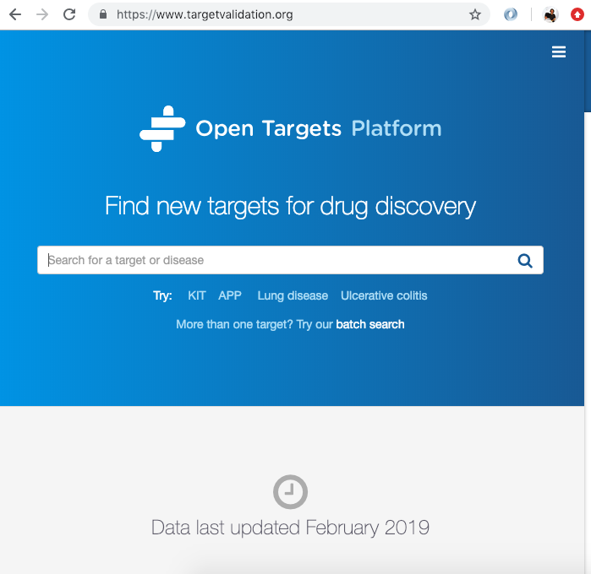
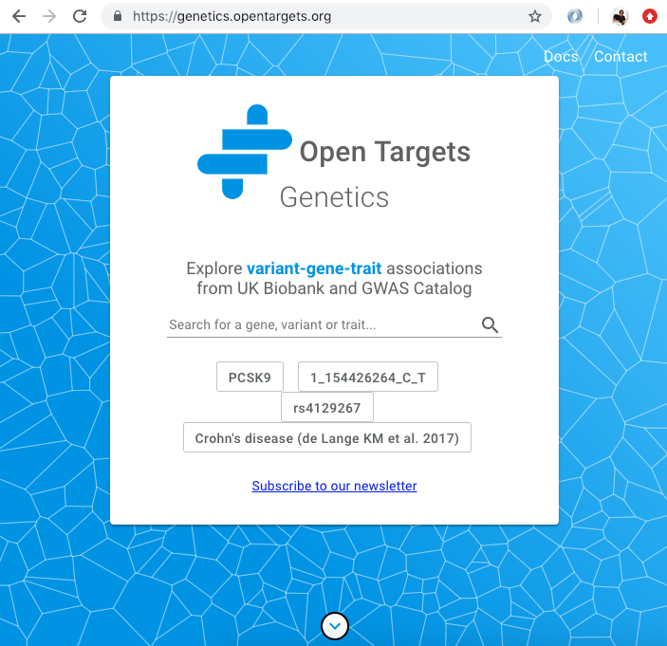
Data integration: web resources
Data integration: Open Targets
https://www.opentargets.org/resources/#open-targets-platform

Slide 12
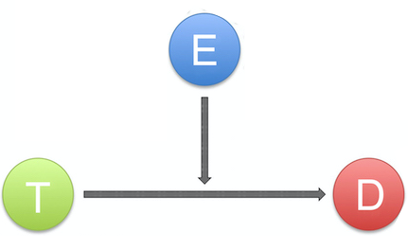
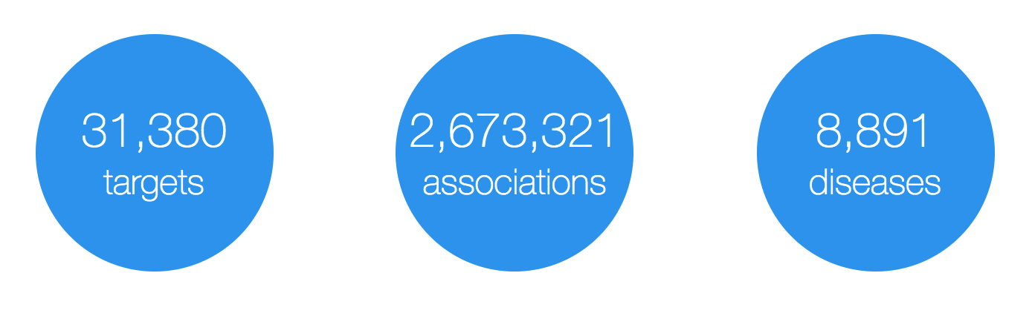
Open Targets Platform: data model
Evidence
(variants, drugs, literature, etc)
Target
(protein and non-protein coding genes)
Disease
(rare and common)
https://www.targetvalidation.org

Slide 13
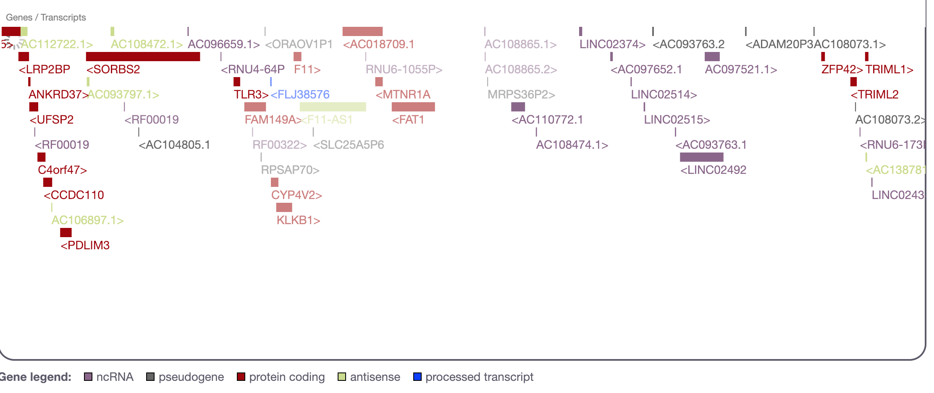
What is a target?
27K
targets
Examples
https://www.targetvalidation.org/target/ENSG00000255248
https://www.targetvalidation.org/target/ENSG00000175482?view=sec:genome_browser

Slide 14
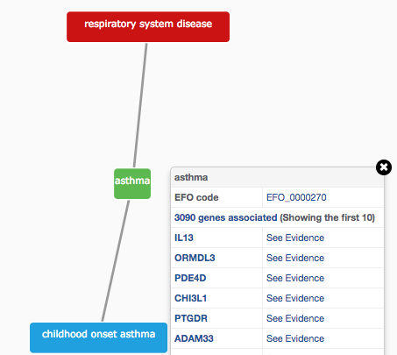
How do we describe our diseases?
Modified version of Experimental Factor Ontology (EFO)
Controlled vocabulary (Coeliac versus Celiac)
Hierarchy (relationships)
Promotes consistency
Increases the richness of annotation
Allow for easier and automatic integration
10K
diseases

Slide 15
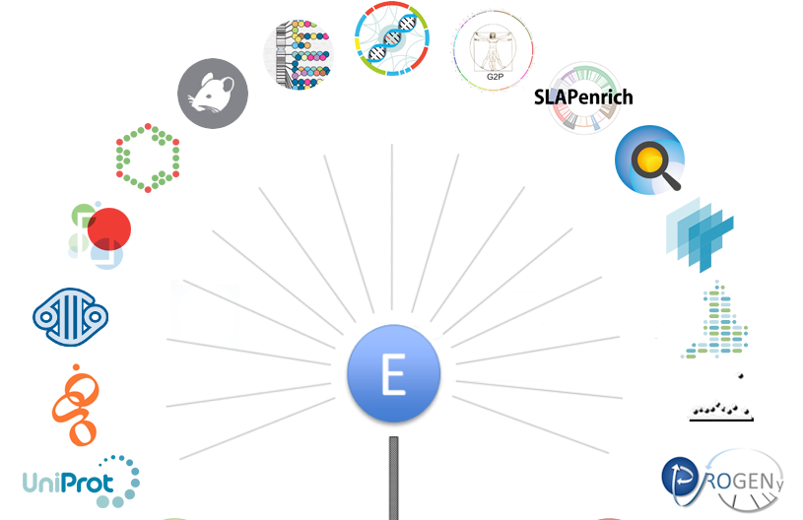
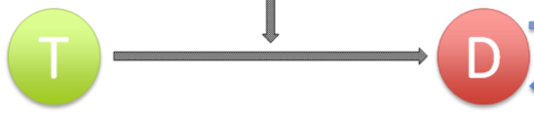
Evidence for our T-D associations
https://docs.targetvalidation.org/data-sources/data-sources

Slide 16
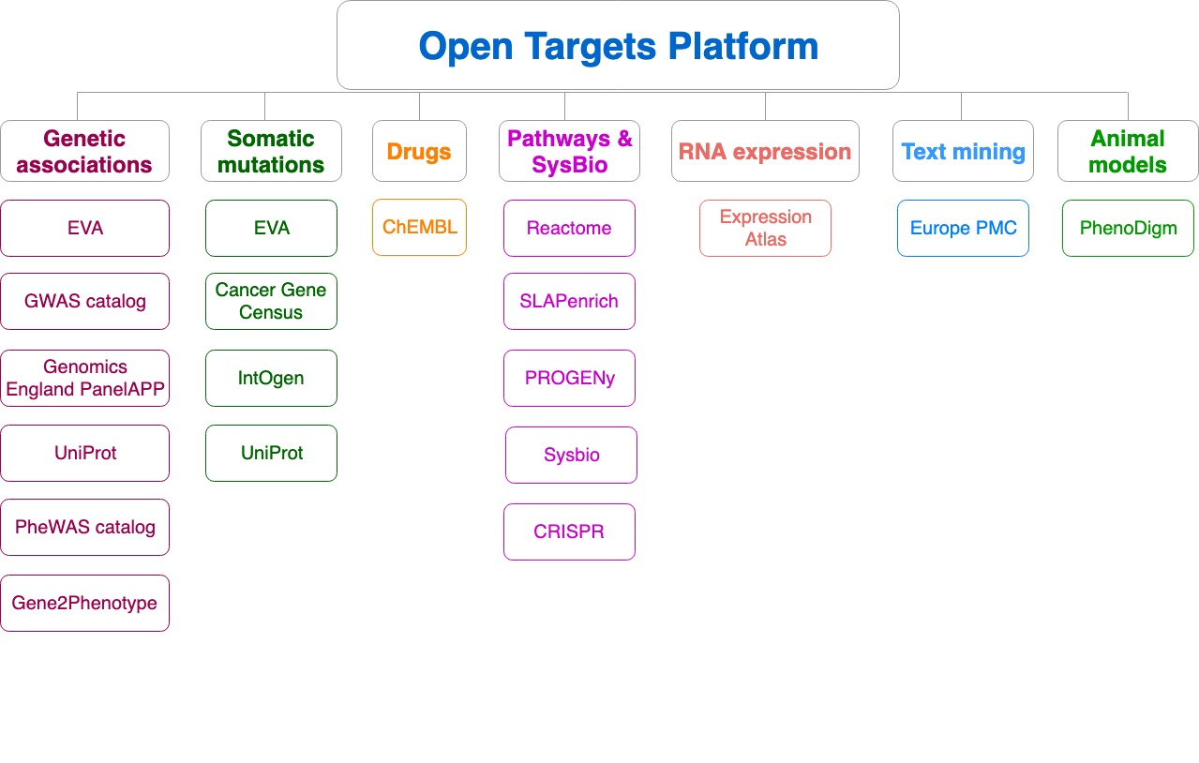
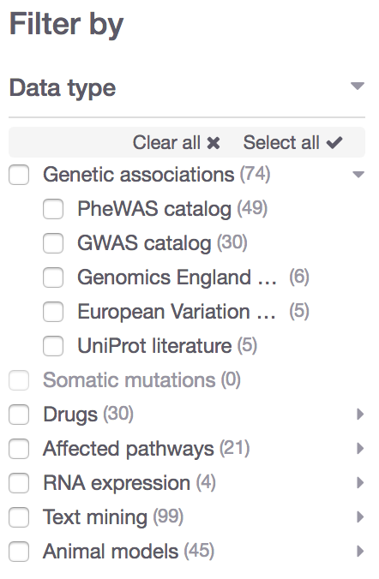
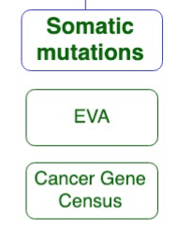
Data sources grouped into data types
Data type
Data source

Slide 17

What can you do with the Open Targets Platform?
Target-disease associations (+ evidence + score)
https://www.targetvalidation.org/evidence/ENSG00000141510/EFO_0000228
Target annotations
http://www.targetvalidation.org/target/ENSG00000141510
Disease annotations
http://www.targetvalidation.org/diseaset/EFO_0000228

Slide 18
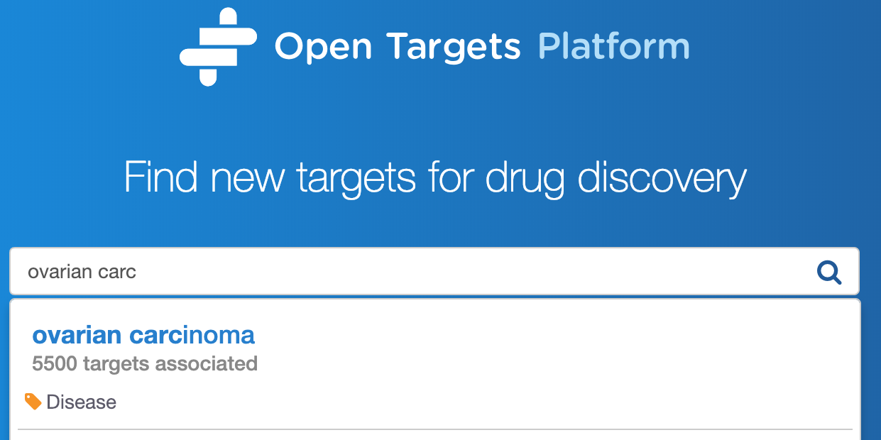
Demo 1
Which targets are associated with my disease?
What is the evidence for the association?
Is there any data to help to prioritise the list of associated targets?
Coursebook: pages 7-16

Slide 20
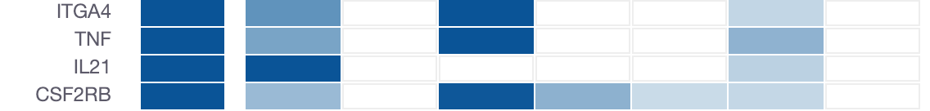
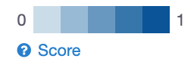
How well supported are the associations?
Association score to convey confidence
More evidence → stronger association score
Different evidence are scored and weighted in different ways
Overall score
Genetic
Somatic
Drugs
Pathways
Expression
Text mining
Animal mod

Slide 21
Evidence score to overall score
Statistical integration, aggregation and scoring
1) Evidence score (e.g. one SNP from a GWAS paper)
2) Data source score (e.g. all SNPs from the GWAS catalog)
3) Data type score (e.g. all sources of Genetic associations)
4) Overall association score
https://docs.targetvalidation.org/getting-started/scoring

Slide 22

Computing the score for one evidence
score = f * s * c
f, relative occurrence of a target-disease evidence
s, strength of the effect of the variant
c, confidence of the observation for the target-disease evidence
f = sample size (cases and controls)
s = predicted functional consequence (VEP)
c = p value reported in the paper
(Factors affecting the relative strength of GWAS Catalog evidence)

Slide 23
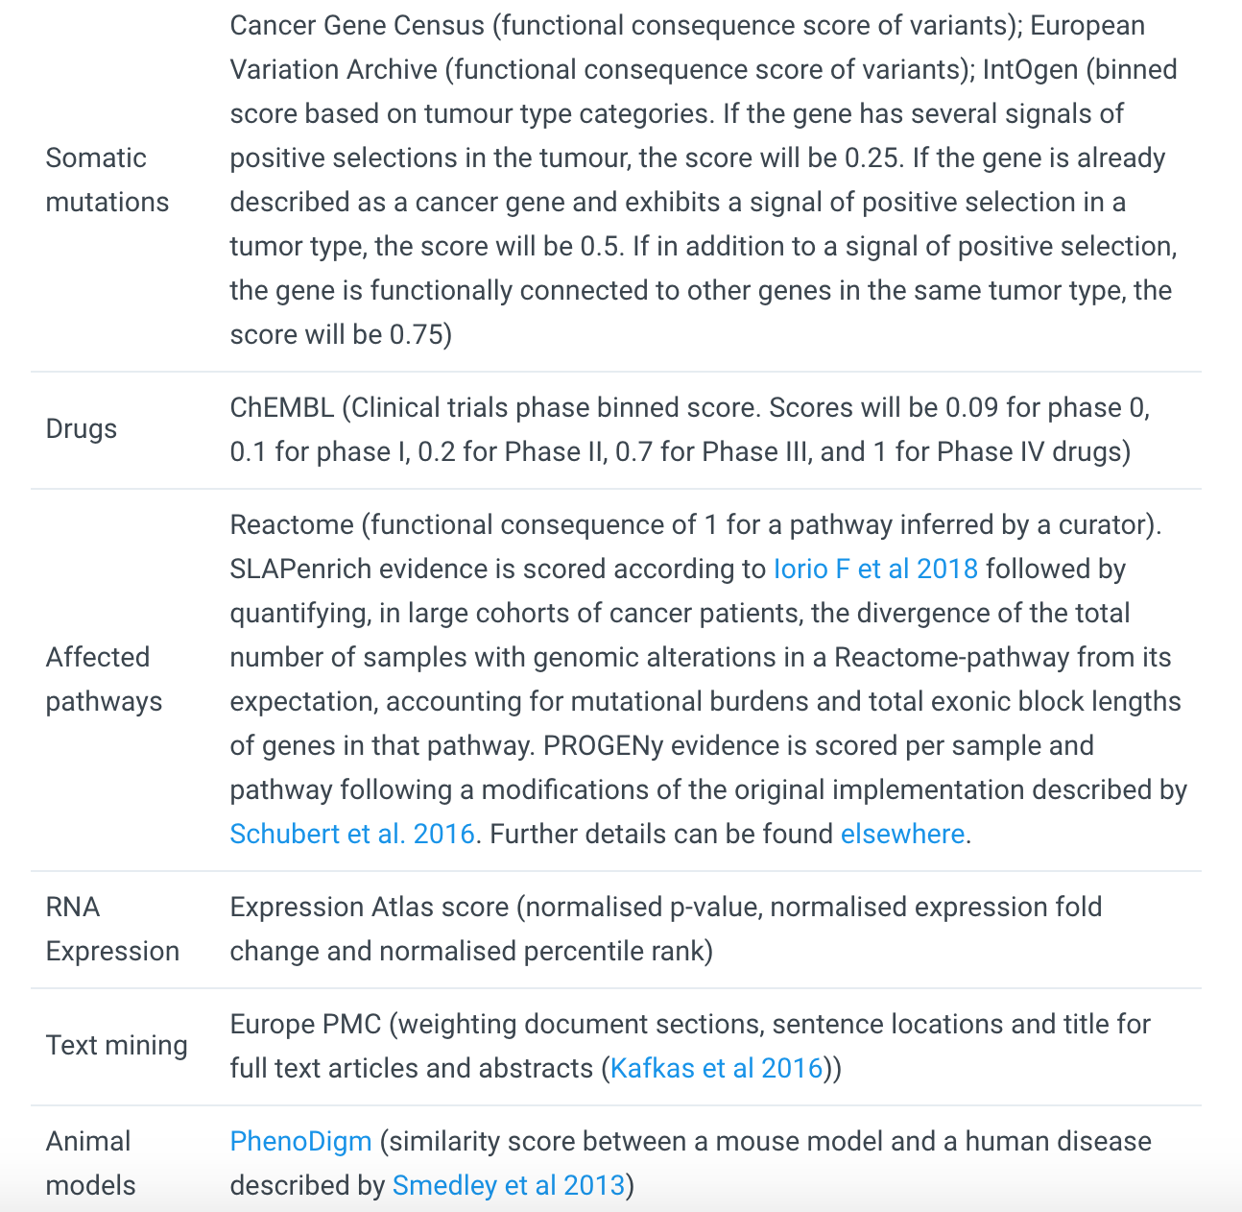
https://docs.targetvalidation.org/getting-started/scoring
Factors affecting the relative strength of the evidence

Slide 24
Harmonic sum
Σ_{H}
*1.0
Genomics England
Score: 0 to 1 (max)
Σ_{H}
*1.0
PheWAS catalog
Σ_{H}
*1.0
European Variation Archive (germline)
Σ_{H}
*1.0
Σ_{H}
Genetic associations
Calculated at four levels:
Evidence
Data source
Data type
Overall
UniProt
Σ_{H}
*1.0
Gene2Phenotype
Σ_{H}
*1.0
GWAS catalog
Σ_{H}
*1.0
Cancer Gene Census
Σ_{H}
*1.0
European Variation Archive (somatic)
Σ_{H}
Somatic mutations
Σ_{H}
*1.0
IntOGen
Aggregation with (harmonic sum)
Σ_{H}
Σ_{H}
*1.0
ChEMBL
Drugs
Σ_{H}
*1.0
Reactome
Note: Each data set has its own scoring and ranking scheme
Σ_{H}
*0.5
SLAPenrich
Σ_{H}
*0.5
Σ_{H}
Pathways &
systems biology
PROGENy
Σ_{H}
*0.5
Sysbio
Σ_{H}
*0.2
Expression Atlas
RNA expression
Σ_{H}
*0.2
Europe PMC
Text mining
Σ_{H}
*0.2
PhenoDigm
Animal models
weight factor
Σ_{H}
S₁ + S₂/2² + S₃/3² + S₄/4² + S_{i}/i²
Σ_{H}
Association

Slide 25
What can you do with the Open Targets Platform?
Target-disease associations (+ evidence + score)
https://www.targetvalidation.org/evidence/ENSG00000141510/EFO_0000228
Target annotations
https://www.targetvalidation.org/target/ENSG00000141510
Disease annotations
https://www.targetvalidation.org/diseaset/EFO_0000228

Slide 26
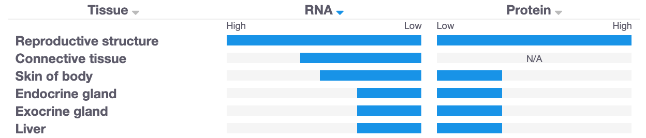
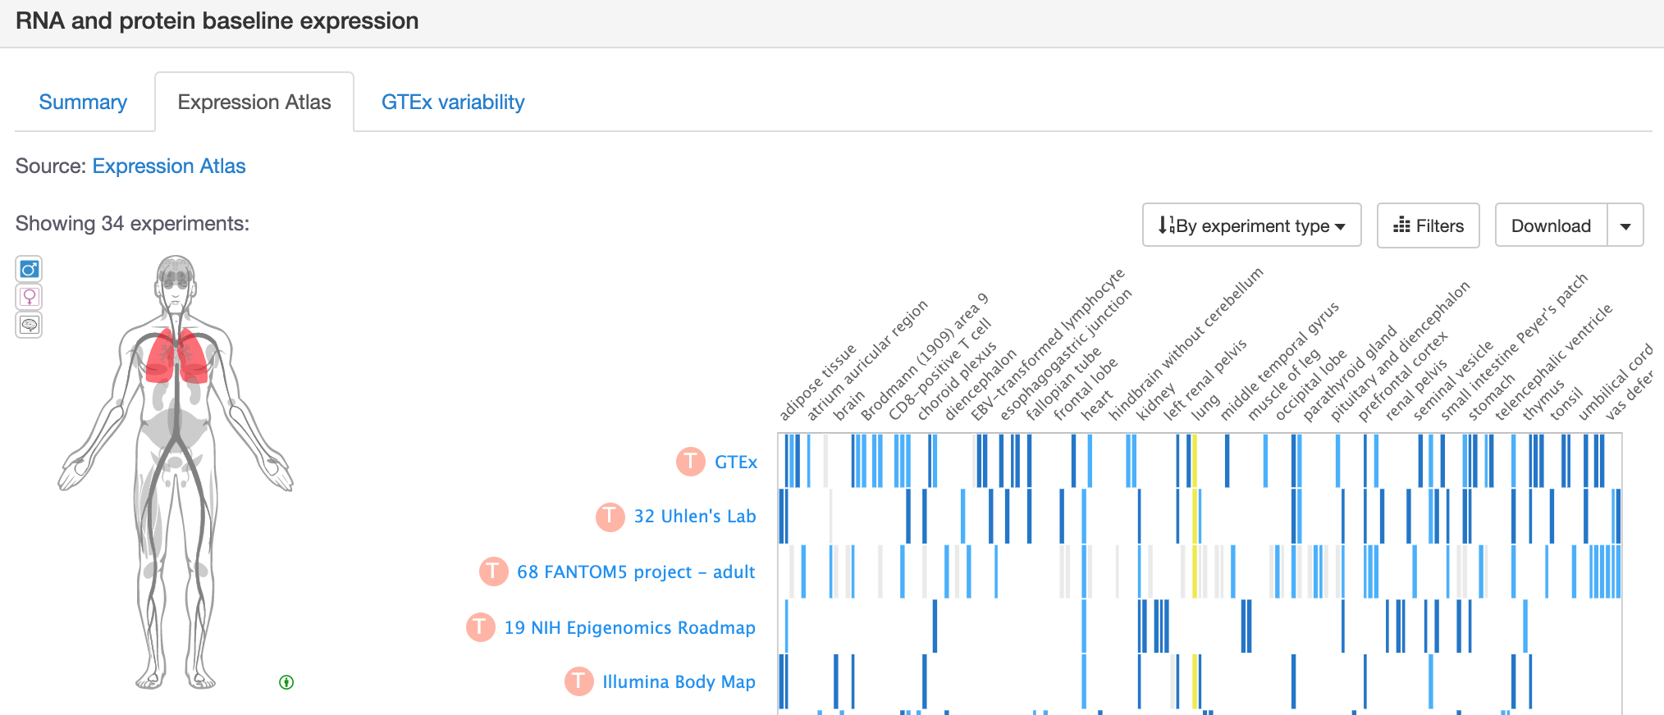
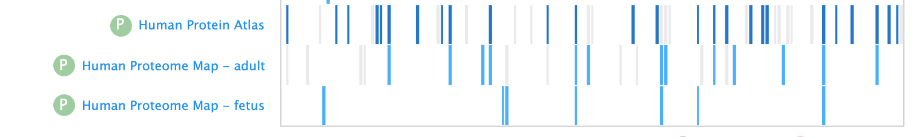
Is my target expressed in the relevant tissue?

Slide 27
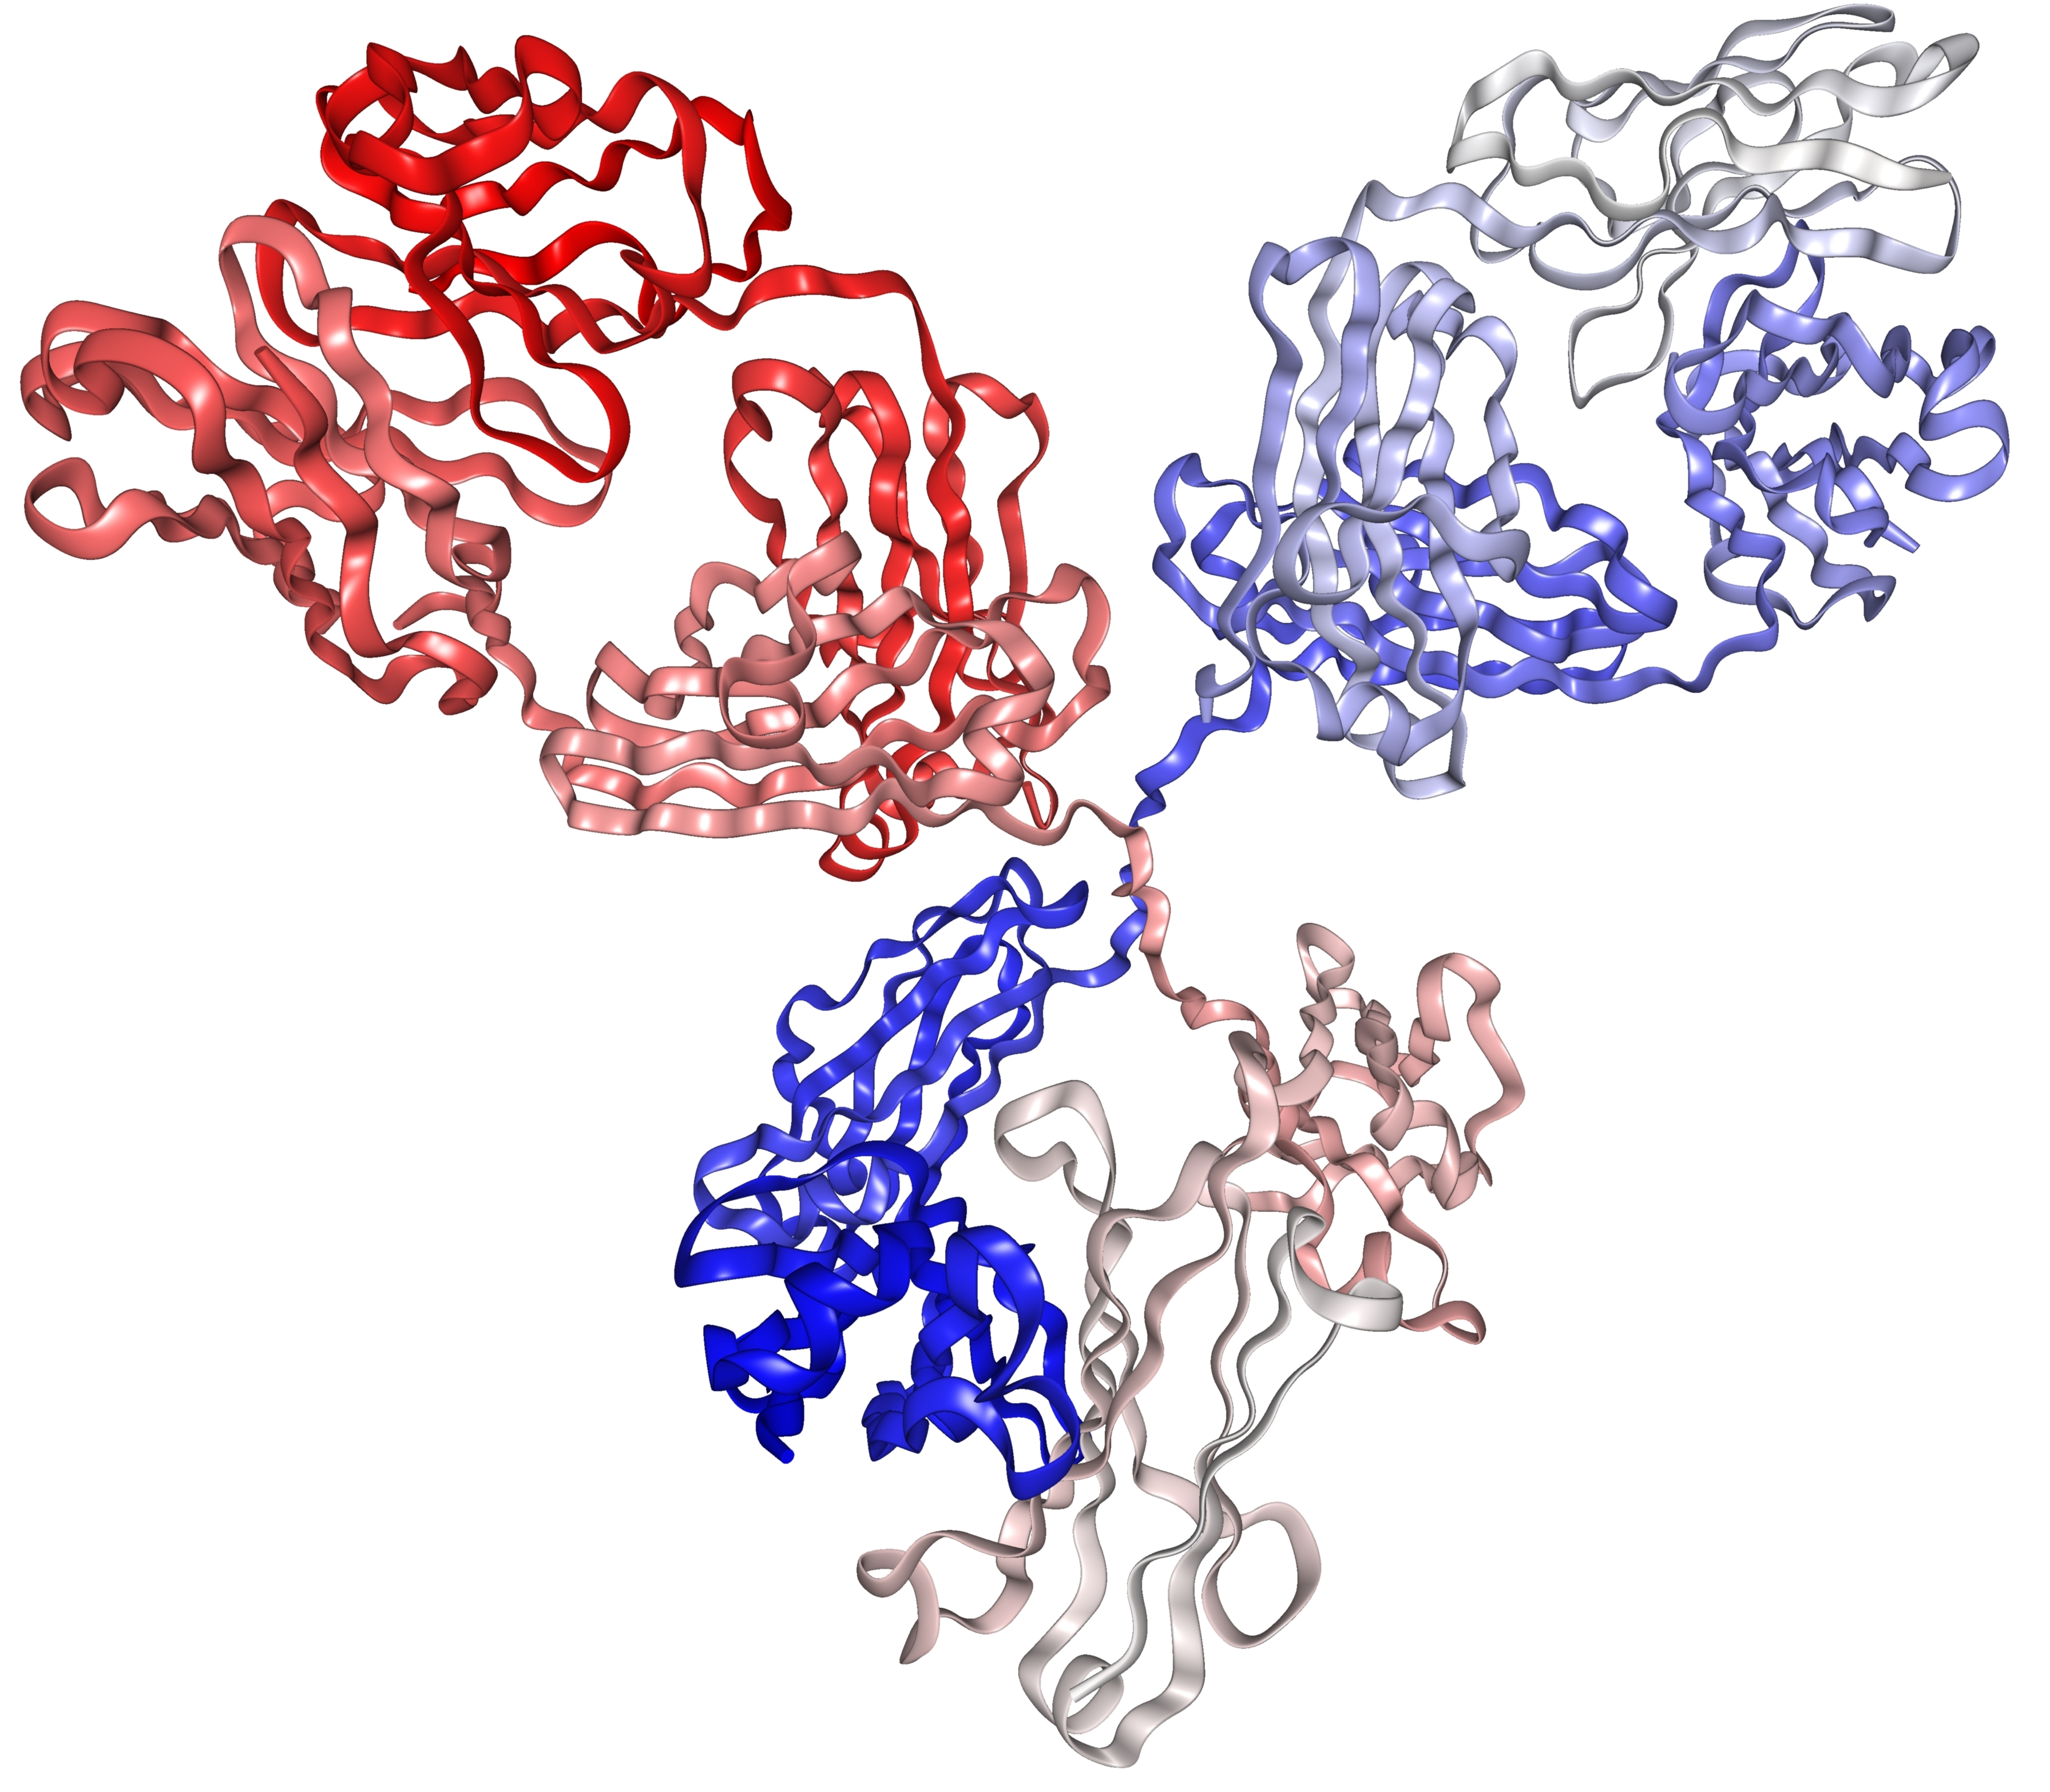
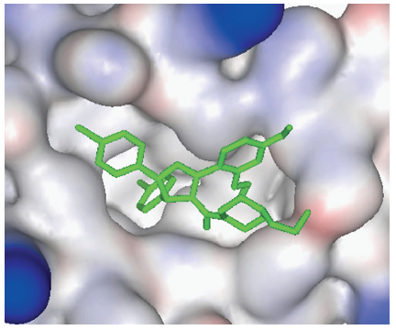
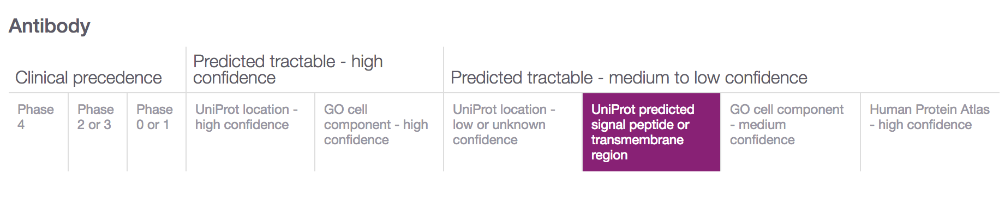
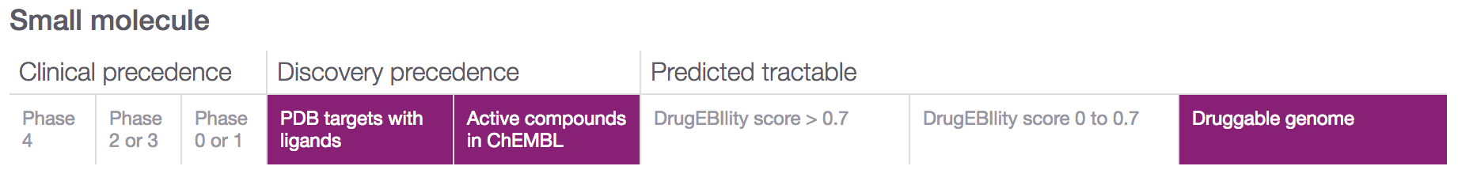
Is my target tractable?
DOI:10.1517/17460441.3.4.391
https://www.immunology.org/structure-antibody-1972

Slide 28
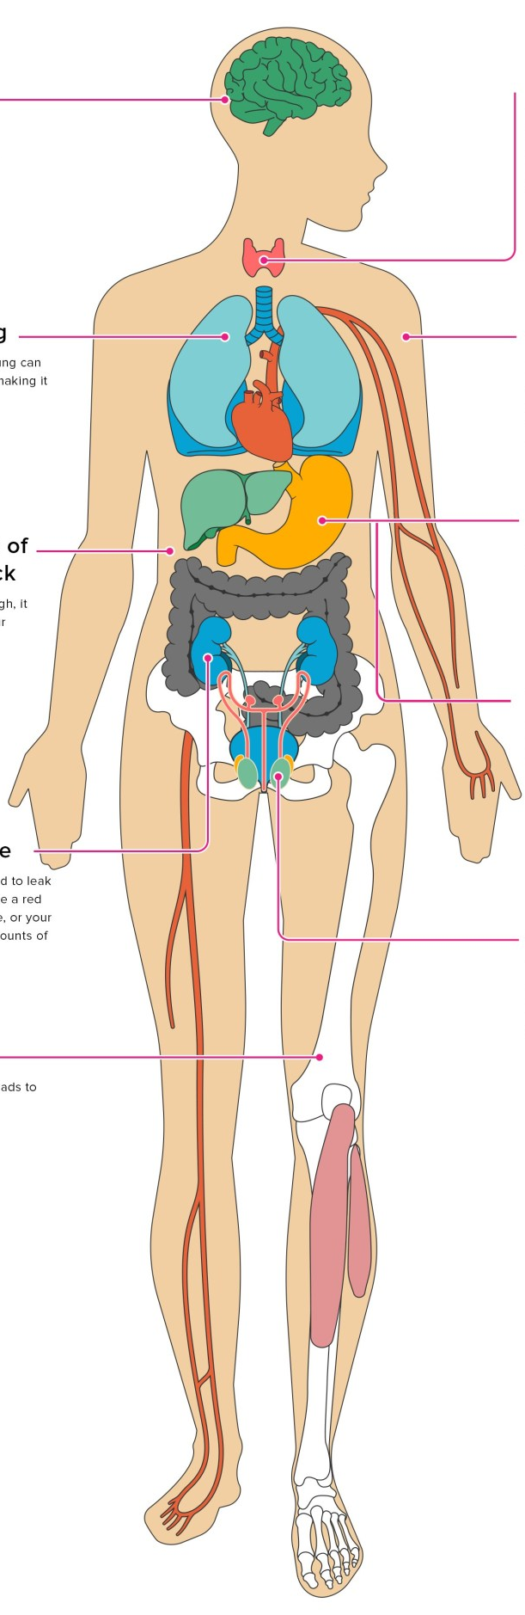
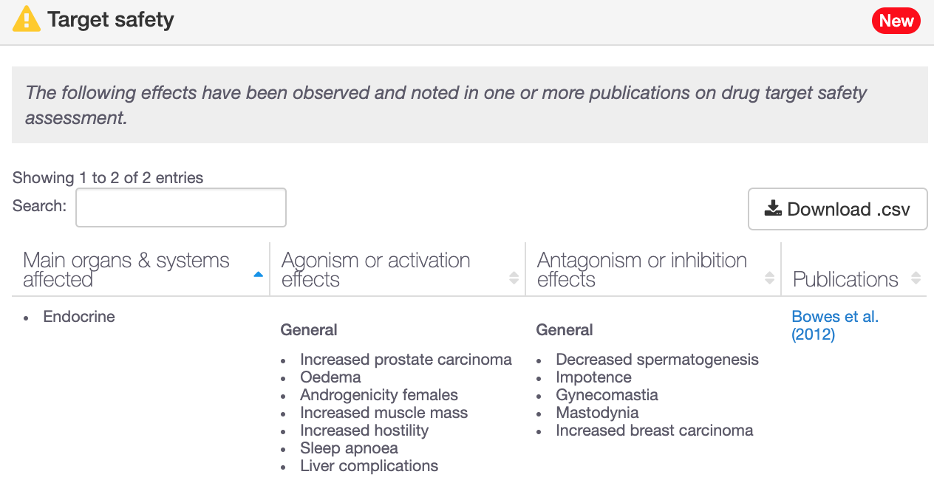
Is my target safe to be modulated?
193 genes with target safety information
Drowsiness
Increased heart rate
Hepatotoxicity

Slide 29
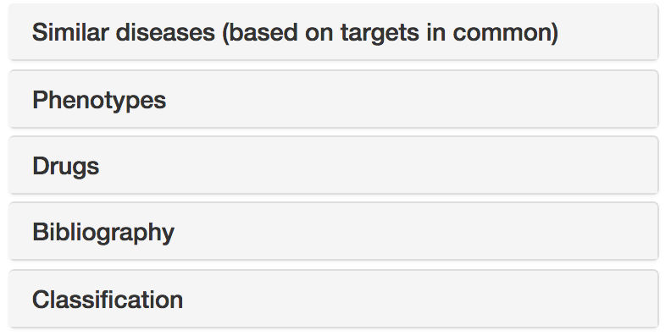




Disease annotations
Disease profile page
https://docs.targetvalidation.org/getting-started/getting-started/disease-profile

Slide 30
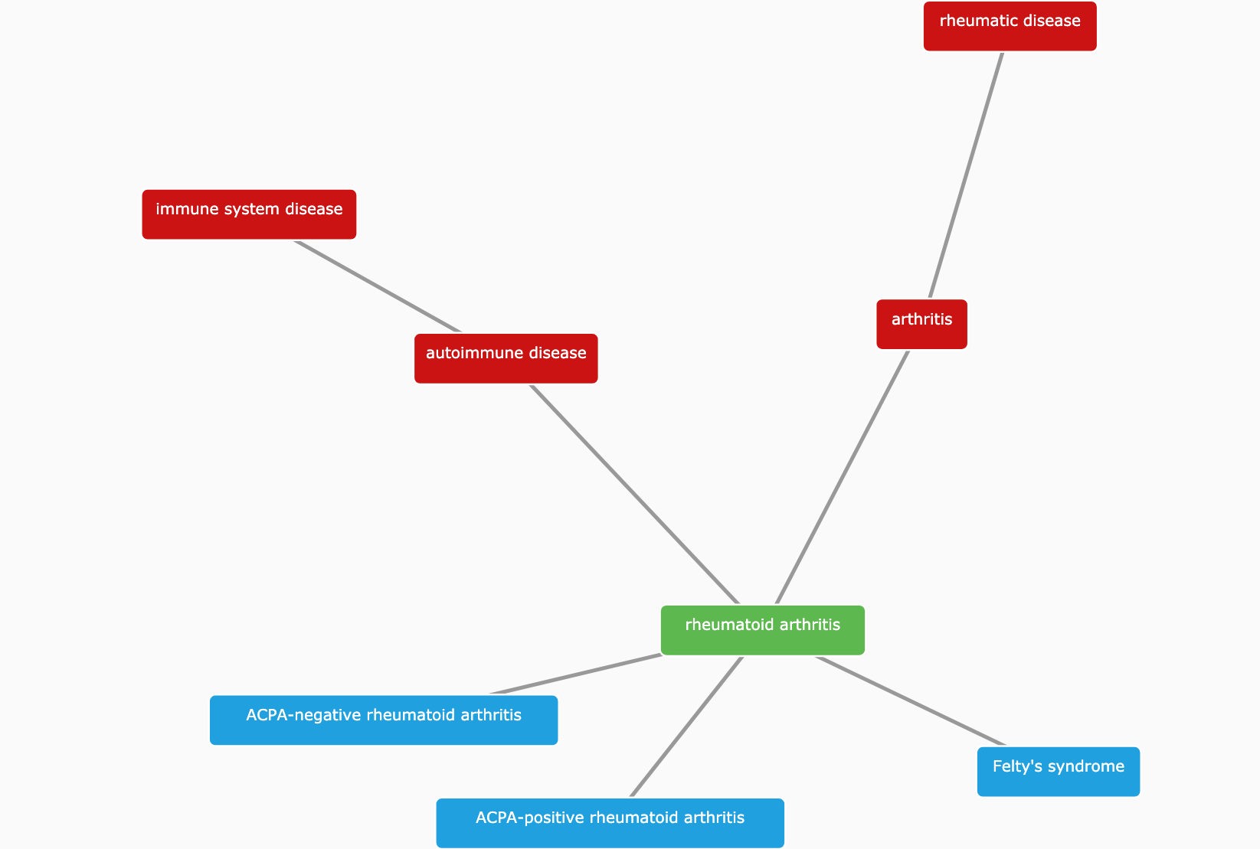
(Disease) Classification
https://www.targetvalidation.org/disease/EFO_0000685

Slide 31
Hands-on time
Demos
Exercises
Target (disease) annotations
Target centric workflow
Durvalumab
IBD
EGRF
Pages 16-25
Pages 26-29

Slide 32
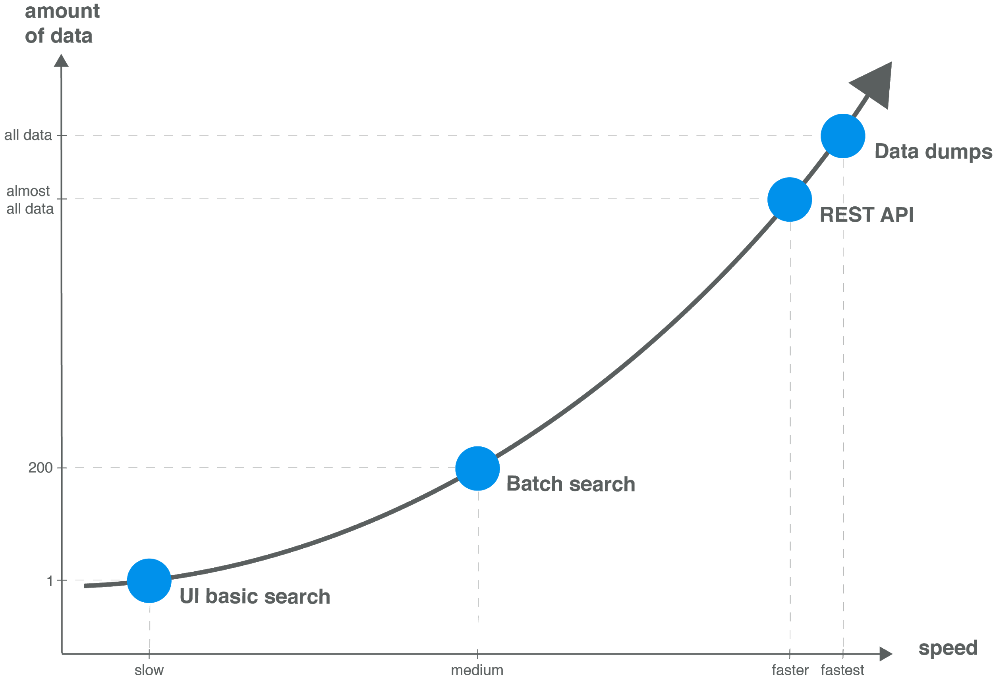
Modes of access → data volume

Slide 33
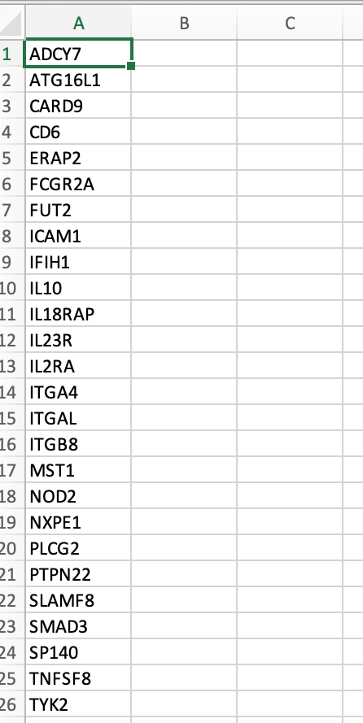
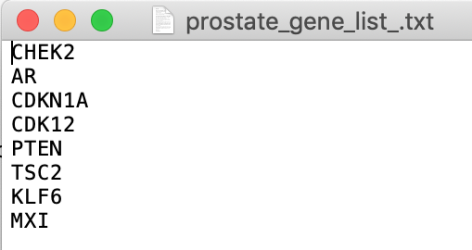
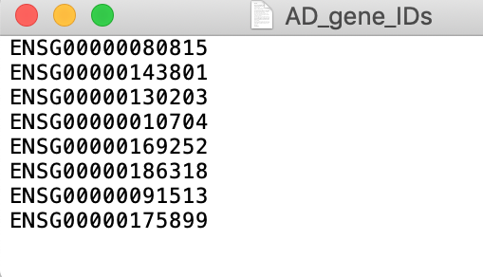
Have you got a list of targets?
Using the web interface, choose
Batch search or
”Your target list” filtering

Slide 34
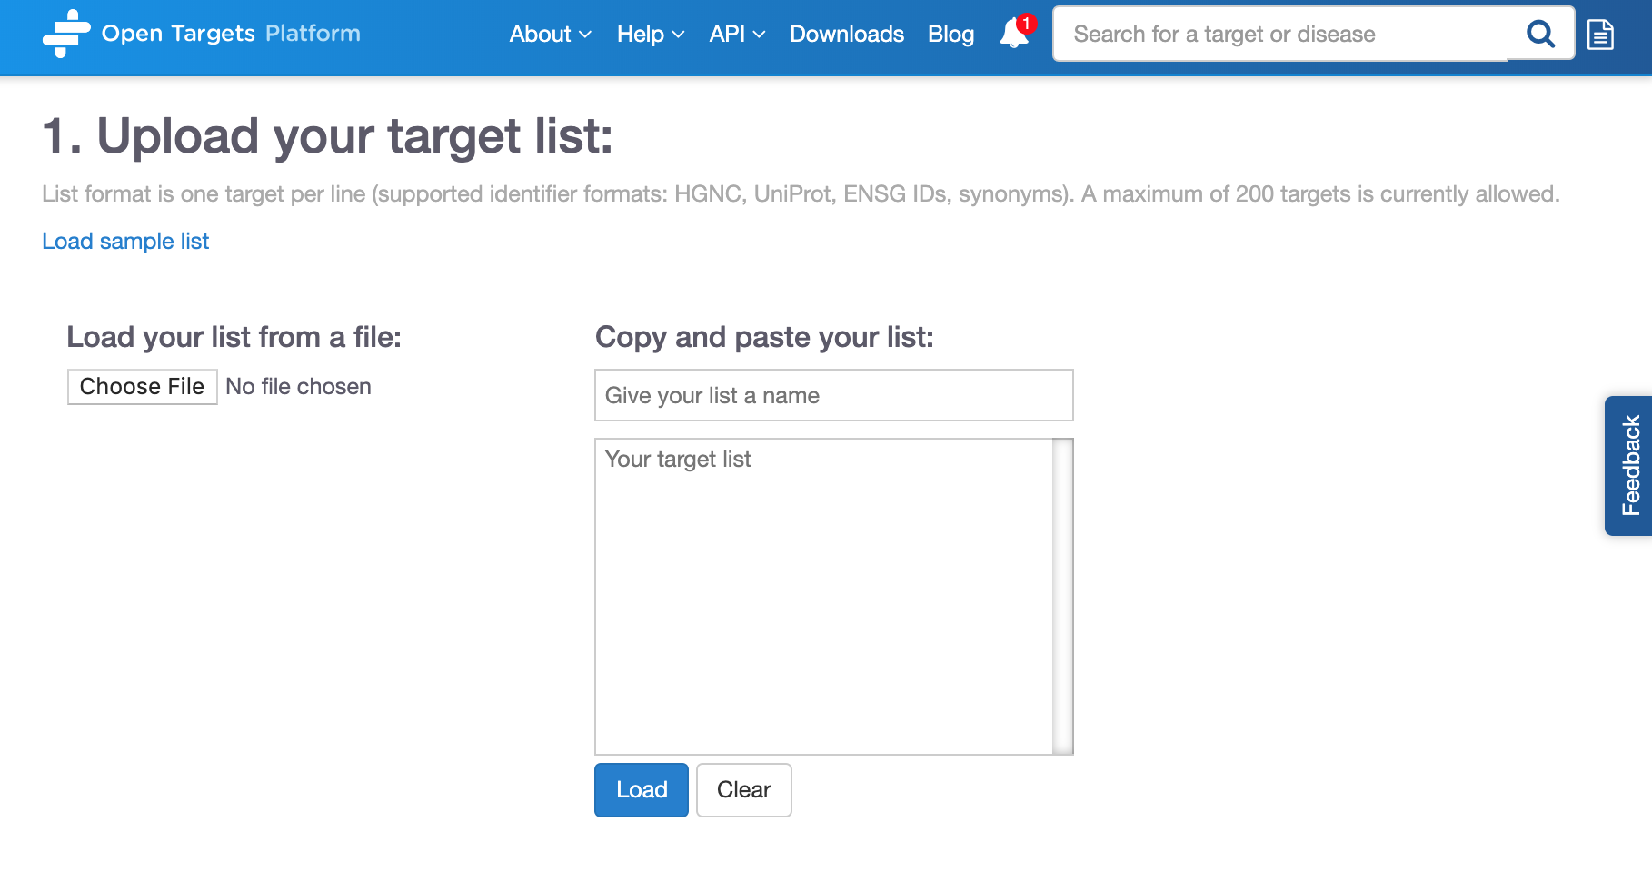
Batch search
https://www.targetvalidation.org/batch-search

Slide 35




Open Targets Platform REST API*
Server
https://platform-api.opentargets.io/v3/platform/
Endpoint
public/association/filter
Parameters
?target=ENSG00000163914&size=10000&fields=target.id&fields=disease.id
Open Targets Python client **
*
https://docs.targetvalidation.org/tutorials/rest-api
**
https://docs.targetvalidation.org/tutorials/python-client

Slide 36
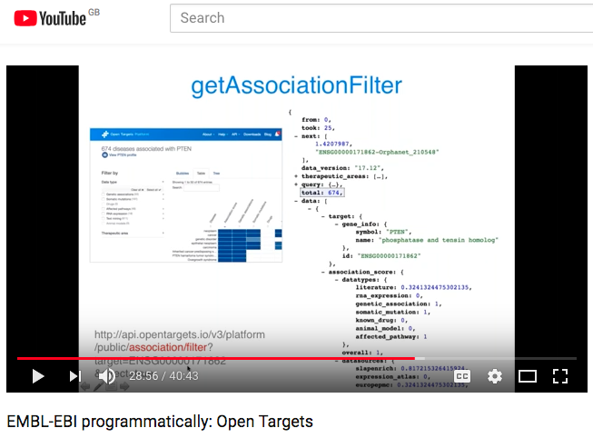
REST API
https://youtu.be/KQbfhwpeEvc

Slide 37
Extra hands-on exercises
E1-E3
Pages 30-32

Slide 38
Wrapping up
Resource of integrated multiomics data
Target identification and prioritisation
Graphical web interface: easy to use
REST-API for larger, more flexible queries
27K
targets
10K
diseases
3.3 M
associations
7.2 M
evidence
June 2019 release, 19.06

Slide 39
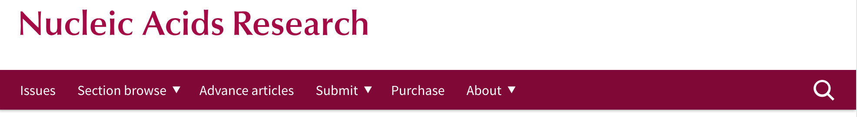
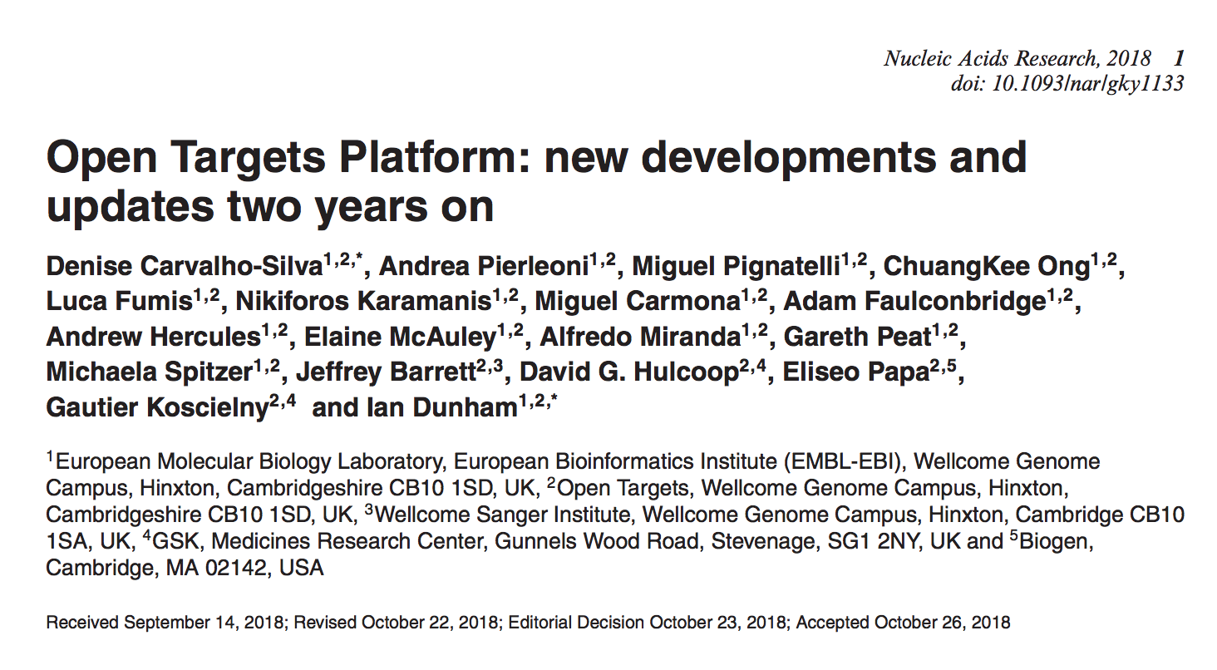
Want to learn more?
http://bit.ly/cite-us

Slide 40






Need help?
https://docs.targetvalidation.org/
support@targetvalidation.org
https://tinyurl.com/opentargets-youtube
@targetvalidate
http://tinyurl.com/opentargets-in
blog.opentargets.org/

Slide 41

Looking for your new career move?
https://www.opentargets.org/jobs

Slide 42
Extra extra extra
Details on data sources to associate
targets and diseases
Other Open Targets resources

Slide 43













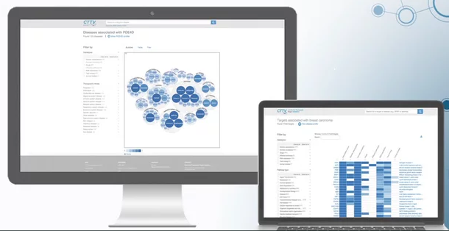


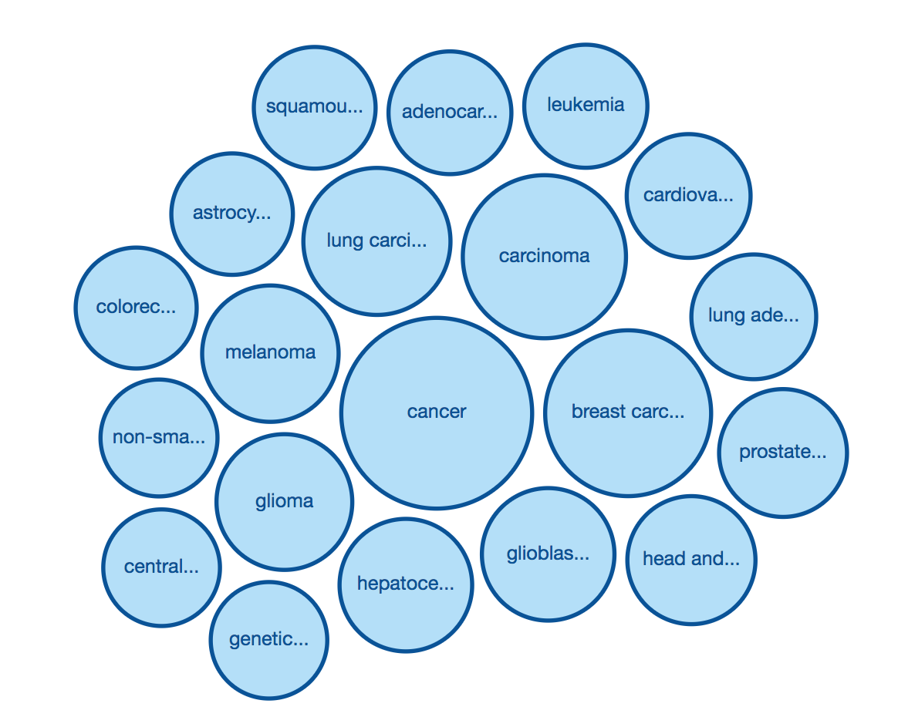
How the data* flows
Target Profile
JSON
summary
document
Validator
Association
score
calculation
Disease profile
* e.g. genetic variants from NHGRI-GWAS catalog

Slide 44
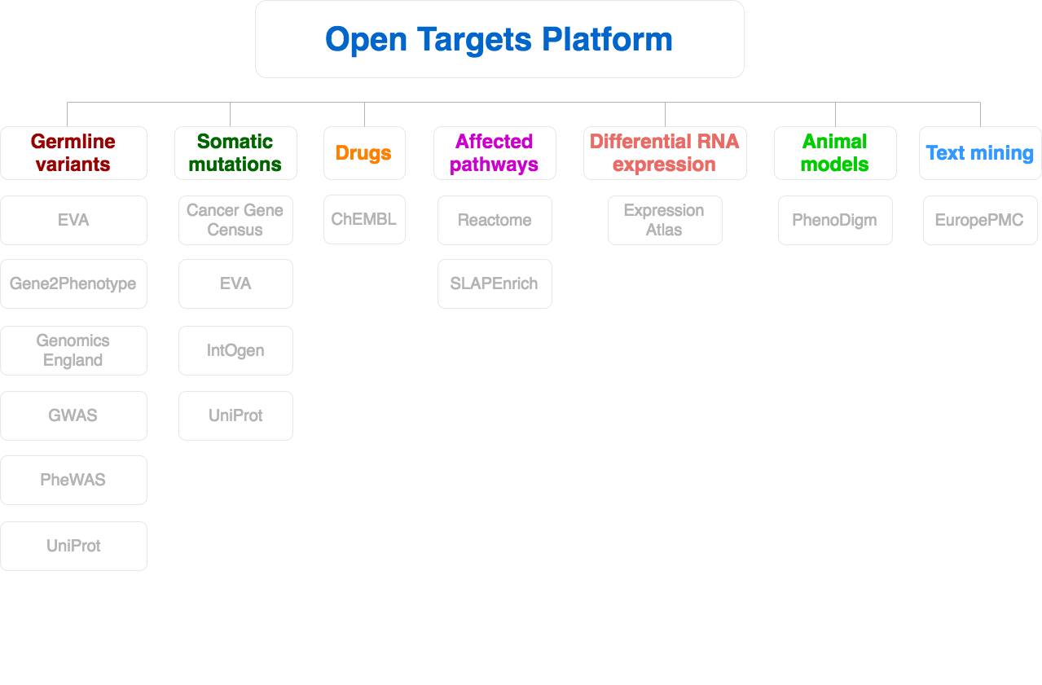
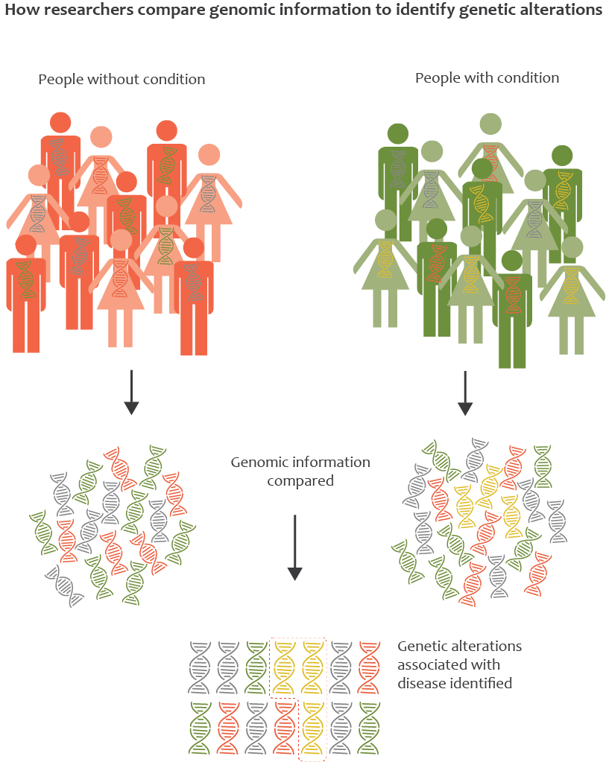
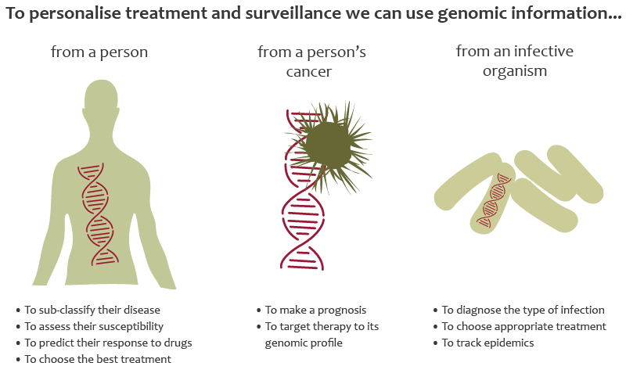



Data sources: GWAS catalog
Genome Wide Association Studies
Array-based chips → genotyping 100,000 SNPs genomewide

Slide 45


Data sources: UniProt
Protein: sequence, annotation, function
Manual curation of coding variants in patients
EMBL-EBI train online

Slide 46

Data sources: Gene2Phenotype
Variants, genes, phenotypes in rare diseases
Literature curation → consultant clinical geneticists in the UK

Slide 47
Data sources: UniProt
Protein: sequence, annotation, function
Manual curation of coding variants in patients
EMBL-EBI train online

Slide 48

Data sources: PheWAS
Phenome Wide Association Studies
A variant associated with multiple phenotypes
Clinical phenotypes derived from EMR-linked biobank BioVU
ICD9 codes mapped to EFO

Slide 49

Data sources: GE PanelApp
Aid clinical interpretation of genomes for the 100K project
We include ‘green genes’ from version 1+ and phenotypes

Slide 50

Data sources: EVA
With ClinVar information for rare diseases
Clinical significance: pathogenic, protective
EMBL-EBI train online

Slide 51

Data sources: The Cancer Gene Census
Genes with mutations causally implicated in cancer
Gene associated with a cancer plus other cancers associated with that gene

Slide 52

Data sources: IntOGen
Genes and somatic (driver) mutations, 28 cancer types
Involvement in cancer biology
Rubio-Perez et al. 2015
Notes:
Somatic mutations from cancer drivers genes across 28 tumor types. We have imported data (2014.12) from 6,792 samples spanning 28 cancer types (Rubio-Perez et al)."

Slide 53

Data sources: ChEMBL
Known drugs linked to a disease and a known target
FDA approved for clinical trials or marketing
EMBL-EBI train online

Slide 54

Data sources: Reactome
Biochemical reactions and pathways
Manual curation of pathways affected by mutations
EMBL-EBI train online

Slide 55

Data sources: SLAPenrich
374 pathways curated and mapped to cancer hallmarks
Divergence of the total number of cancer samples with genomic alterations
Mutational burden and total exonic block length of genes

Slide 56

Data sources: PROGENy
Comparison of pathway activities between normal and primary samples from The Cancer Genome Atlas
Inferred from RNA-seq: 9,250 tumour and 741 normal samples
EGFR, hypoxia, JAK.STAT, MAPK, NFkB, PI3K, TGFb, TNFa, Trail, VEGF, and p53
Notes:
Linear regression model
from 14 tumour types.

Slide 57
Data sources: SysBio
Curation of four systems biology papers
Available for six gene lists: ~ 400 genes
Late onset Alzheimers, cognitive decline, CHD, and IBD
Score: p-values or rank-based scores if available, otherwise 0.5 is assigned.
Notes:
Linear regression model
from 14 tumour types.

Slide 58

Data sources: Expression Atlas
Baseline expression for human genes
- target profile page
Differential mRNA expression (healthy versus diseased):
- target-disease associations
EMBL-EBI train online

Slide 59

Data sources: Europe PMC
Mining titles, abstracts, full text in research articles
Target and disease co-occurrence in the same sentence
Dictionary (not NLP)
EMBL-EBI train online

Slide 60

Data sources: PhenoDigm
Semantic approach to associate mouse models with diseases

Slide 61






Target-Disease Association Score
EuropePMC
(Text Mining)
UniProt
(Manual Curation)
Overall
ChEMBL
(Manual Curation)
VERY simplified diagram

Slide 62

How to run our REST endpoints (option 1)
Paste the URL in the location bar of your browser

Slide 63



Slide 64

How to run our REST endpoints (option 2)
Command line e.g. CURL –X GET

Slide 65

How to run our REST endpoints (option 3)
Use our free Python client*
Advantage: you can change the way the associations are scored e.g. increase the weight given to text mining data
* http://opentargets.readthedocs.io/en/stable/index.html

Slide 66


User interface or REST-API?
Scale and volume of your search or results
Flexibility in the search
Visualisation of the results
Notes:
http://api.opentargets.io/v3/platform/public/evidence?id=d0ad72d0e798449346de04eb3b189e10

Slide 67



REST API calls: some examples*
https://api.opentargets.io/v3/platform/public/search?q=alzheimer%27s
https://api.opentargets.io/v3/platform/public/association/filter?target=ENSG00000142192
https://api.opentargets.io/v3/platform/public/association/filter
?target=ENSG00000142192&direct=true
https://api.opentargets.io/v3/platform/public/evidence/filter?target=ENSG00000142192&disease=EFO_0000249&datasource=uniprot&direct=true

Slide 68

Open Targets REST API
https://api.opentargets.io/v3/platform/docs/swagger-ui
Private: methods used by the UI to serve external data. Subject to change without notice

Slide 69



How to search
https://api.opentargets.io/v3/platform/public/search?q=PTEN

Slide 70



How to get all diseases associated with a target
http://api.opentargets.io/v3/platform
/public/association/filter?
target=ENSG00000171862
&direct=true
Notes:
http://api.opentargets.io/v3/platform/public/association?id=ENSG00000171862-EFO_0000616

Slide 71



How to get the score for an association
http://api.opentargets.io/v3/platform/
public/association?id=ENSG00000171862
-EFO_0000616
Notes:
http://api.opentargets.io/v3/platform/public/association?id=ENSG00000171862-EFO_0000616
http://api.opentargets.io/v3/platform/public/association/filter?target=ENSG00000171862

Slide 72



How to get the evidence for an association
http://api.opentargets.io/v3/platform/public/evidence/filter?target=ENSG00000198947&disease=Orphanet_98896&datatype=genetic_association
Notes:
http://api.opentargets.io/v3/platform
/public/evidece/filter?
target=ENSG00000171862
&disease=Orphanet_2563
http://api.opentargets.io/v3/platform/public/association?id=ENSG00000171862-EFO_0000616
http://api.opentargets.io/v3/platform/public/association/filter?target=ENSG00000171862

Slide 73


Data downloads

Slide 74

LINK
http://link.opentargets.io/
LINK: Literature coNcept Knowledgebase
Subject / predicate / object structured relations
From PubMed abstracts
Proof of Concept
Further developement

Slide 75


Addressing text mining shortcomings
Entities: genes, diseases, drugs
Concepts extracted via NLP (Natural Language Processing)
28 M documents, 500 M relations
http://blog.opentargets.org/link/

